Slide 1
Six-Point Movement & Agartala Conspiracy Case
North South University
Dhaka, Bangladesh

Slide 2
Political Roadmap:
The Six-Point program's political aspirations go back to 23rd June 1949, when the East Pakistan Awami Muslim League came into being for safeguarding the regional autonomy of the Bengali people. The party was formed at Rose Garden in KM Das Lane of old Dhaka city, ushering the Bengali people's hope for progress and prosperity. During the first Grand Convention of Awami League in November 1950, some noted Awami League leaders, including Maulana Abdul Hamid Khan Bhashani, Huseyn Shaheed Suhrawardy, Abul Hashim, and Sheikh Mujibur Rahman advocated for the adoption of a right federal structure in Pakistan.

Slide 3
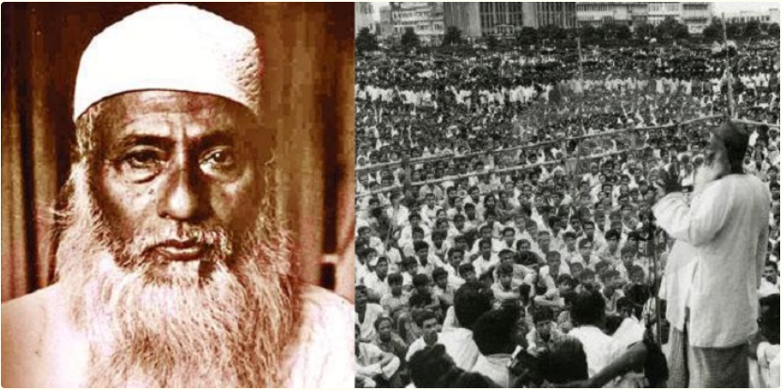

Slide 4
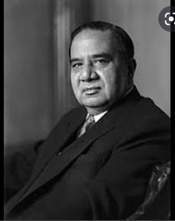

Pakistani leadership foiled the general elections plan undertaken by Prime Minister Hoseyn Shaheed Suhrawardy under the constitution of 1956.
গণতন্ত্রের মানসপুত্র হোসেন শহীদ সোহরাওয়ার্দী

Slide 5
The Six-Point Program :
The initial move in Lahore could bring only a marginal dividend for Sheikh Mujib politically. Once the Awami League Executive Committee reached a consensus in favor of Six-Points on 21st February 1966, it set out an important milestone in its political history.
The plan was presented in a big public rally at the Chittagong Lal Dighi Maidan on 25th February. The program was then endorsed in Awami League Party Council at the Dhaka Eden Hotel on 18-19th March. A booklet entitled Our demands for existence: Six-Point program ( Amader Bachar Dabi: Choi dofa/ছয় দফাঃ আমাদের বাঁচার দাবি ) was published and distributed among the party activists for large scale publicity.

Slide 6
Six-Point demands provided an excellent opportunity to encounter the civil-military autocracy that came to power in October 1958. Thus, the Six-Point directions were the culmination of issues and the logical outcome of unmet resolutions raised in the early phases of Pakistan's political history.

Slide 7
The worst mistake was to implicate Mujib in a highly controversial conspiracy case known as the 'Agartala Conspiracy Case' when he was already under arrest. People asked, how could he be a party to the conspiracy since he was already in prison? (G. W. Choudhury, Ibid, 1972).

Slide 8
SIX POINTS:
1. The Constitution should provide for a Federation of Pakistan in its true sense on the Lahore Resolution, and the parliamentary form of government with supremacy of a Legislature directly elected based on universal adult franchise.
2. The Federal Government shall deal with only two subjects: defense and foreign affairs, while all residuary issues were to be vested in the federating units.
3. There should be two separate freely convertible currencies for the two wings, or one currency with two different Banking Reserve to prevent the inter-wing flight of capital.
4. The power of taxation and revenue collection shall be vested in the federating units. The Federal Government will receive a share to meet its financial obligations.
5. Economic disparities between the two wings shall be made to disappear through a series of economic, fiscal, and legal reforms.
6. A militia or para-military force must be created in East Pakistan, which has no defense of its own.

Slide 9
The first two demands were also identical to Jinnah's 14-Points placed in 1929 in response to the Neheru Report published earlier. However, the dilemma on national issues was that East Pakistan represented nearly 60% of Pakistan's total population, but demographically it possessed one-third of West Pakistani territories.

Slide 10
The massive electoral defeat of the Muslim League candidates in the provincial elections of 1954 was an acid test for its leadership.
Ayub Khan called Sheikh Mujib a ‘secessionist’.

Slide 11
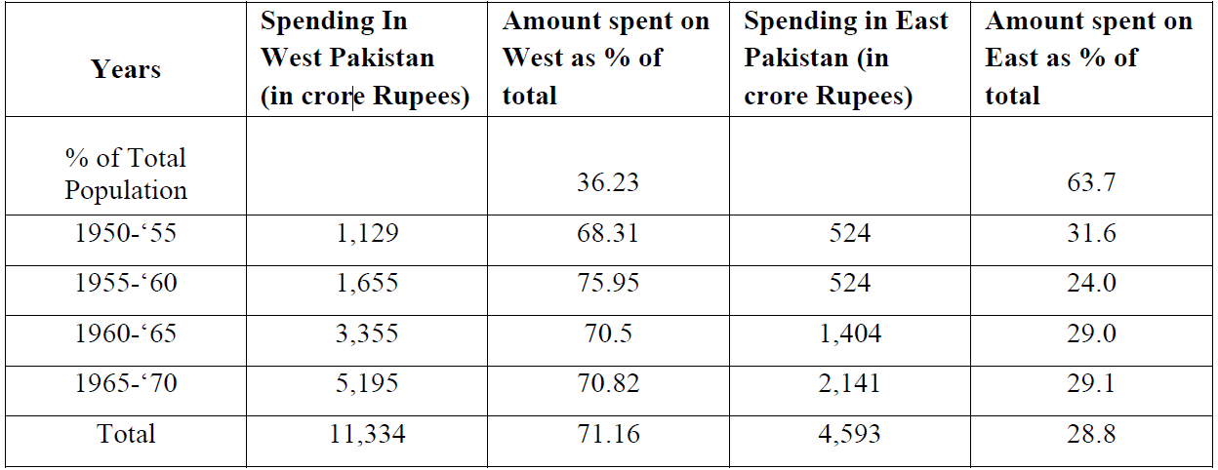
East-West disparity in expenditure:

Slide 12
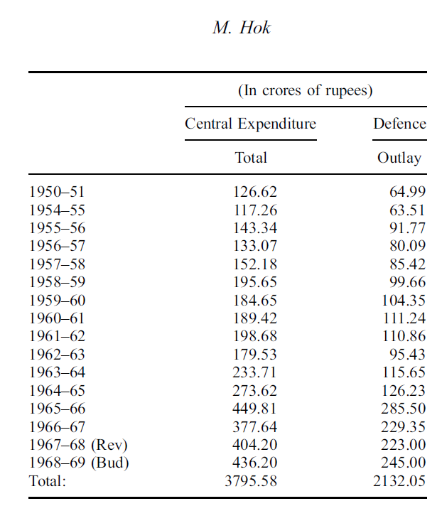
Out of a central revenue expenditure of Rs. 3796 crores in 16 years as given in the Table below Rs. 2132 crores or more than 56 per cent was defense expenditure. Out of the amount of Rs. 2132 crores hardly 10 per cent could have been spent in East Pakistan.

Slide 13
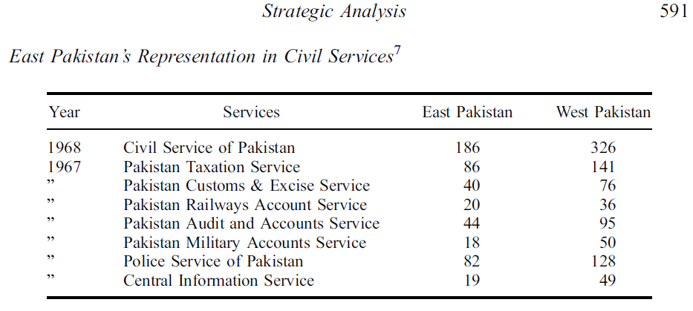

Slide 14
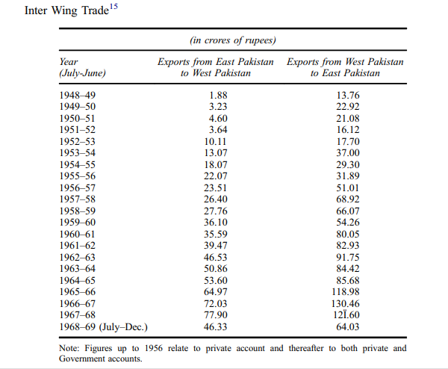

Slide 15
The Table in the previous slide shows that the income gap in twenty years doubled both in percentage and absolute terms, which was more alarming to the Bengali nationalist aspirants.
Six-Point program appeared as a radical approach to many analysts because it went beyond Pakistan's federal structure debate for economic justice.

Slide 16
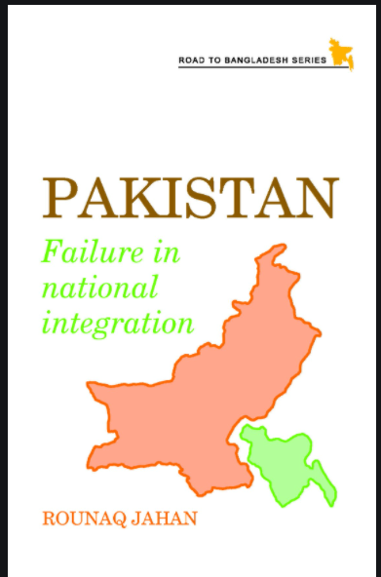

Textual Analysis, Expert Opinion & Reactions:
In her book , entitled, Pakistan: Failure in National Integration, political scientist professor Rounaq Jahan (1972) maintained that the Six-Point mandate made it difficult for the East Pakistan Awami League to reconcile with any other West Pakistan-based political parties.

Slide 17
Summarizing the reactions of different political parties to the six-point formula, Dr. Rounaq Jahan commented that:
“The Council Muslim League described the six points as demand for confederation, not a federation. The Jama'at- i-Islami branded it as a separatist design; the Nizam-i-Islam rejected it as a unilateral, dictatorial move on Mujib's part; and the National Awami Party dismissed it because it was parochial and did not include any measures to free East Pakistan”.

Slide 18
Original or official name of the Case: “STATE VS SHEIKH MUJIBUR RAHMAN & OTHERS”. There were 35 convicts of Agartala Conspiracy Case.
The Agartala Conspiracy Case was a testing ground for Pakistan.
Regional autonomy movement/Mass upheavals of 1969

Slide 19
Zahurul Haque (1935-1969) was a sergeant of the Pakistan Airforce. He was the 17th among the 35 people accused in the Agartala case. He was arrested in December 1967 on the charge of planning an armed insurrection against the government.
Brutal killing of Sergeant Zahurul Haque, an accused of the Agartala conspiracy case on February15, 1969 and of Dr.Shamsuzzoha, a Rajshahi University teacher on February18, 1969.
Killing of Assad

Slide 20
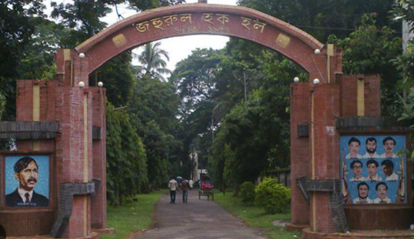
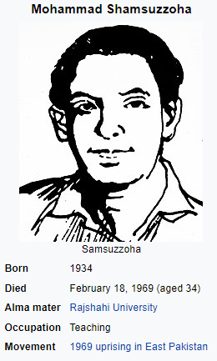


Slide 21
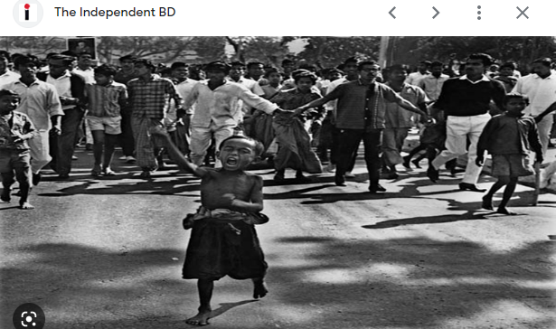
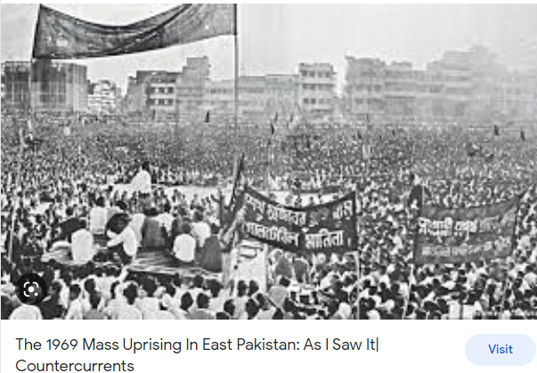

Slide 22
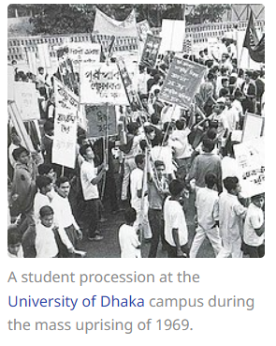
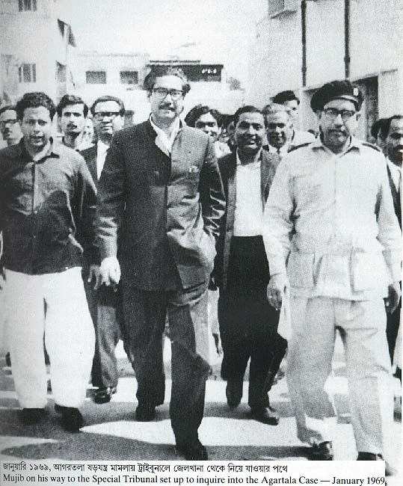

Slide 23
Eventually, under the Defence Act of Pakistan, the government arrested Awami League leader and his colleagues Tajuddin Ahmad, Khandoker Mushtaq Ahmed, Mansoor Ali, and Zahur Ahmed Chowdhury on 8th May 1966. In a press note, the Pakistan Home Ministry maintained that this group kept a close link with the Indian Deputy High Commissioner in Dhaka, P. N. Ojah.
It further suggested that some of them had visited Agartala and met Colonel Mishra, Major Menon, and other Indian officials to discuss their secret plan
To foil the drive, Police killed 11 people in the Adamji industrial area in Narayangonj, Tejgaon industrial area in Dhaka, and arrested almost 800 people from different places in the region. As a result of the repressive government measures, the Six-Point Movement temporarily lost its momentum but 'enhanced the popularity' of Sheikh Mujibur Rahman across the political spectrum.

Slide 24
One of the high profile convicts of the Agartala Conspiracy Case Colonel Shawkat (Retd) commented as follows:
“But as a matter of fact, several military officers and civil servants were involved in the case as we wanted to liberate the country from Pakistan through an armed Revolution under the leadership of Bangabandhu Sheikh Mujibur Rahman, which was not directly linked to the Six-Point”.

Slide 25
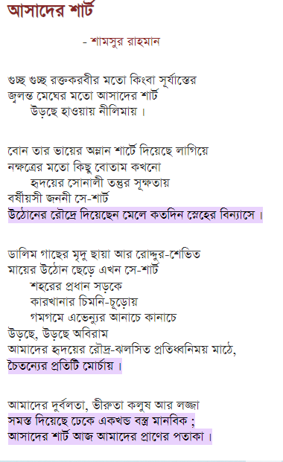
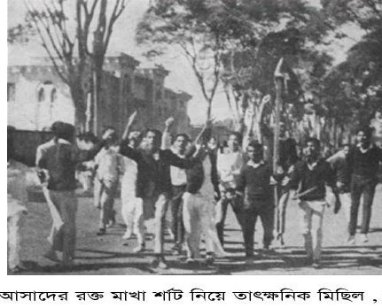
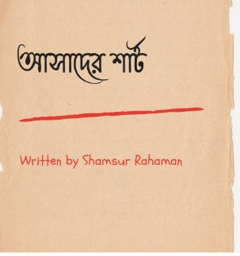

Slide 26
Implications & Conclusions:
Magna Carta (or Charter) of the Bengali freedom
Rising aspirations of the Bengali people
Growth of Bengali nationalism
Politics of regionalism based on the ‘two-economy theory’.
Bengali identity politics
Fall of the military dictator, Ayub Khan
Mass upheavals of 1969 & 1970 general election
Emergence of Bangladesh

Slide 27
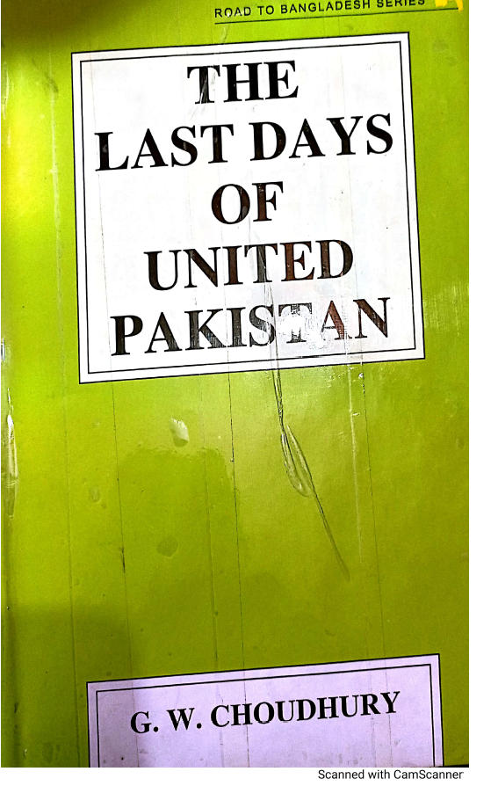
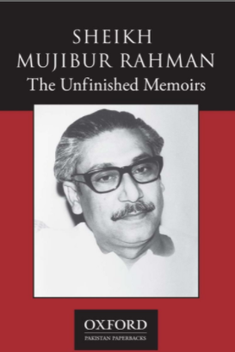

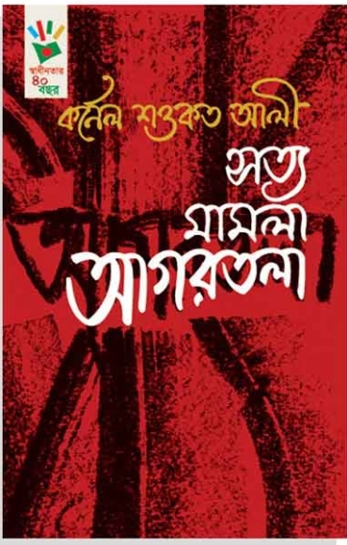
References :

